Slide 1
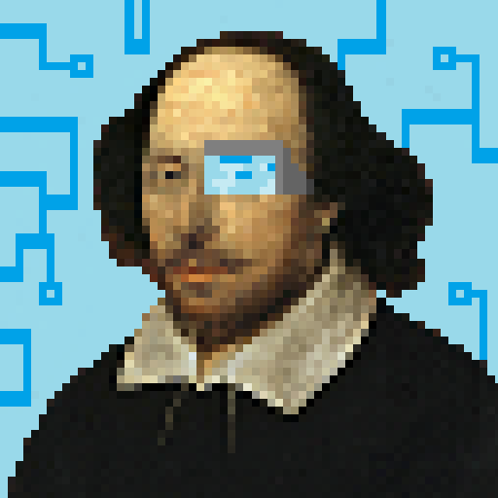
A Bionic Bard Production

Slide 2
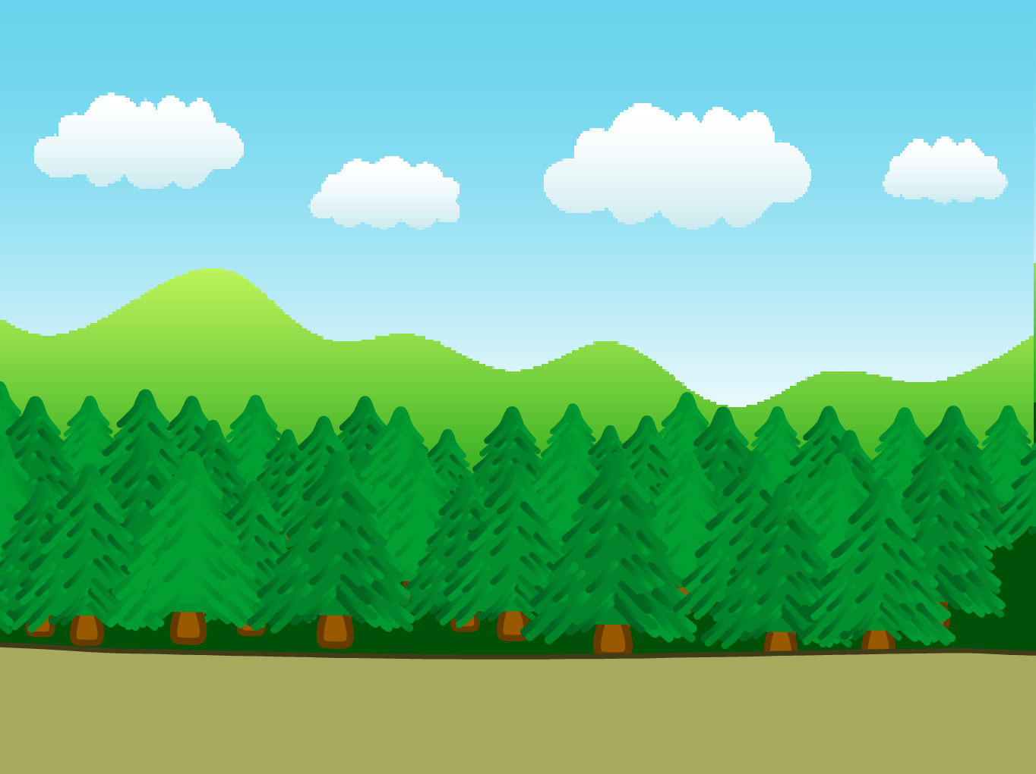


Slide 3
You are a Turtle
You alone protect the balance between Good and Evil
You have beloved Turtle Eggs to protect
You are a cute li’l dude
You beat the Bunny in a race, earning the eternal wrath of Bunnies worldwide

Slide 4

Thwart the Evil Bunnies
Bunnies are hostile
They are jealous due to their defeat at the hands of you, the Turtle
They are after your precious Turtle Eggs
They can be defeated by distributing Easter
Eggs to them, which will diminish their hatred
Different kinds of Bunnies

Slide 5
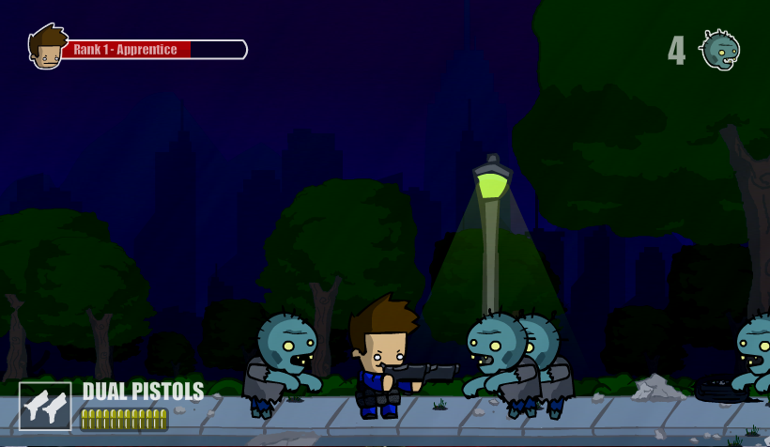
Inspiration
Gameplay inspired by flash game Zombocalypse
Finite side-scroller, where you defend
against waves of Zombies
Taking a less violent approach with
Boss Turtle

Slide 6
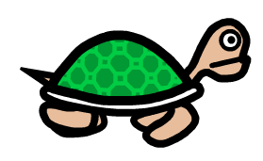
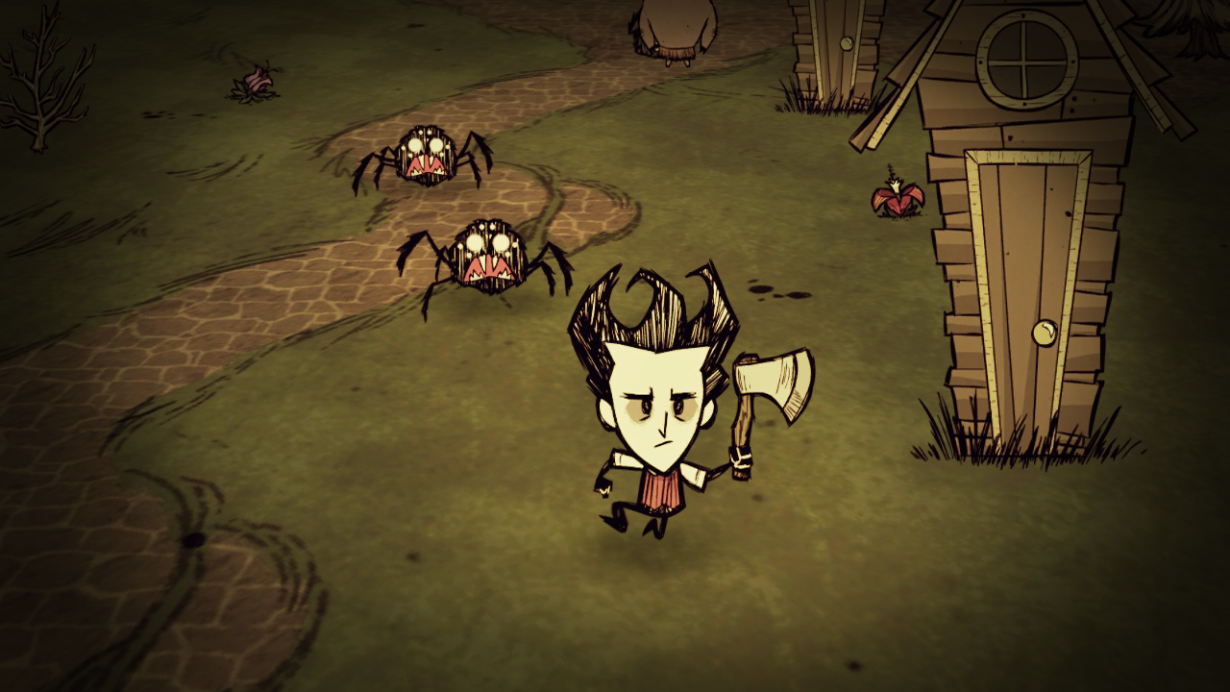

Why Play This Game?
Who wouldn’t want to play as this guy?
Animation-rich environment, for lively creatures/world
Aiming for lively, animation rich environment, as inspired by Don’t Starve

Slide 7
Art Style
Prototype image to right
Bold lines and bright colors

Slide 8
Rules (part 1 of 2)
Purpose: You must safely protect the 5 Turtle Eggs at the center of the map from waves of Bunnies approaching from the left and right
Win condition: Survive the wave of Bunnies
Lose condition: All of your eggs are stolen, or your HP runs out

Slide 9
Rules (part 2 of 2)
Different types of Bunnies can stun you for 1-2 seconds or make you lose HP
Losing too much HP makes you exhausted
To defend against Bunnies, you must push them off the map, or appease them by giving them Easter Eggs
You are able to shield yourself momentarily by hiding inside your shell
Achievements and upgrades earned by appeasing Bunnies

Slide 10
Challenges
Balancing item upgrades. Not too OP, not too meh – just about right
Making sure the hitboxes are right since this is a fast-paced game
Making sure turtle can/can’t be hit when in attack/defense mode, respectively

Slide 11
The First Step… Initial Prototypes
Finite side-scrolling map mechanics
Basic Turtle movement (left, right, give egg)
Basic Bunnies implementation (approach and steal egg)
Simple enemy wave mechanics
Launching eggs

Slide 12
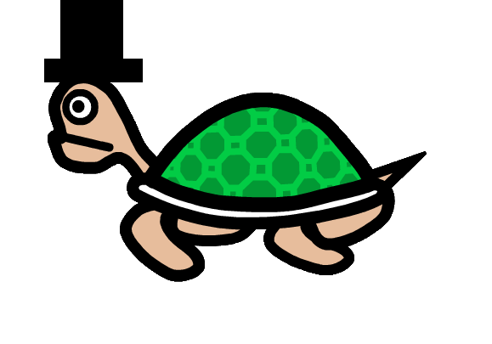
Thanks for your time!

